Slide 1
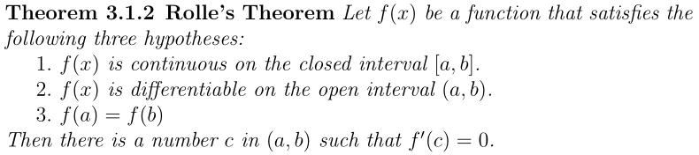
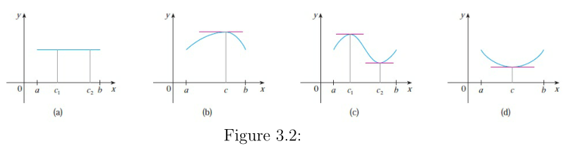
Section 4.2 The Mean Value Theorem

Slide 2
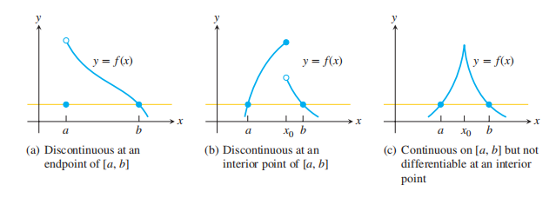
The hypotheses of Theorem 3 are essential. If they fail at even one point, the graph may not have a horizontal tangent.

Slide 3


Slide 4
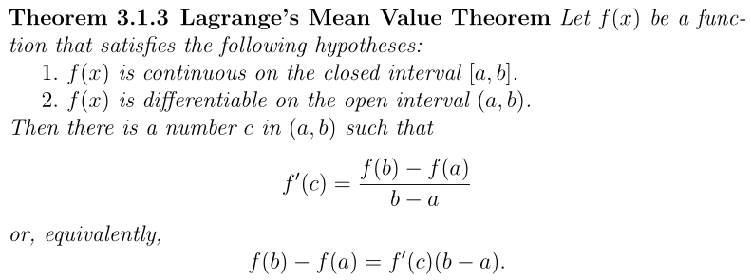
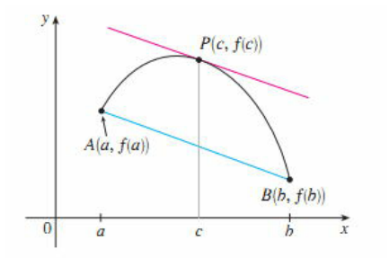
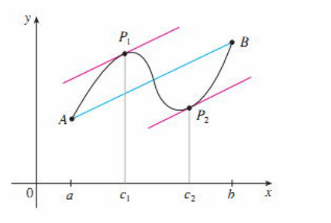

Slide 5
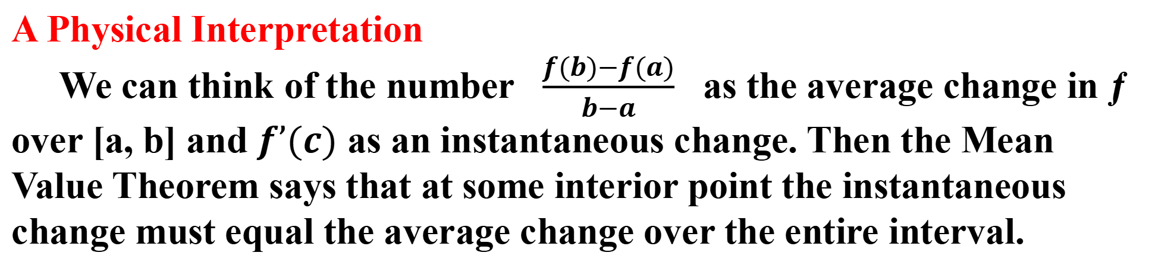
A Physical Interpretation
We can think of the number $\frac{f(b)−f(a)}{b−a}$ as the average change in ƒ over [a, b] and $f’(c)$ as an instantaneous change. Then the Mean Value Theorem says that at some interior point the instantaneous change must equal the average change over the entire interval.

Slide 6
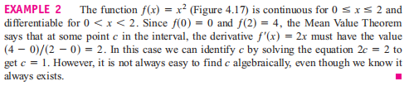
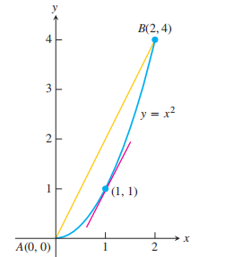

Slide 7
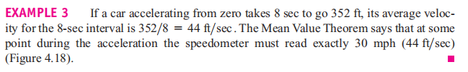
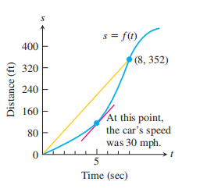

Slide 8

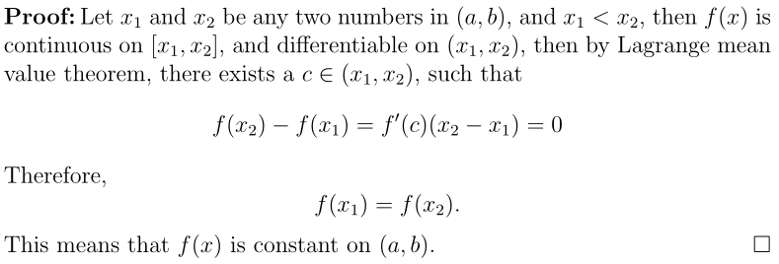

Slide 9

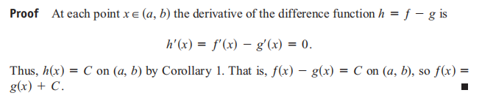

Slide 11
Example 5. Assume the object or body is falling freely from rest with acceleration 9.8 m/sec² We assume the position s(t) of the body is measured positive downward from the rest position (so the vertical coordinate line points downward, in the direction of the motion, with the rest position at 0). Find the velocity v(t) and position function s(t).

Slide 12

Exercises:
Find the function with the given derivative whose graph passes through the point P.

Slide 13

Find the body’s position at time t

Slide 14
Homework: P236: 4, 30

